Slide 1
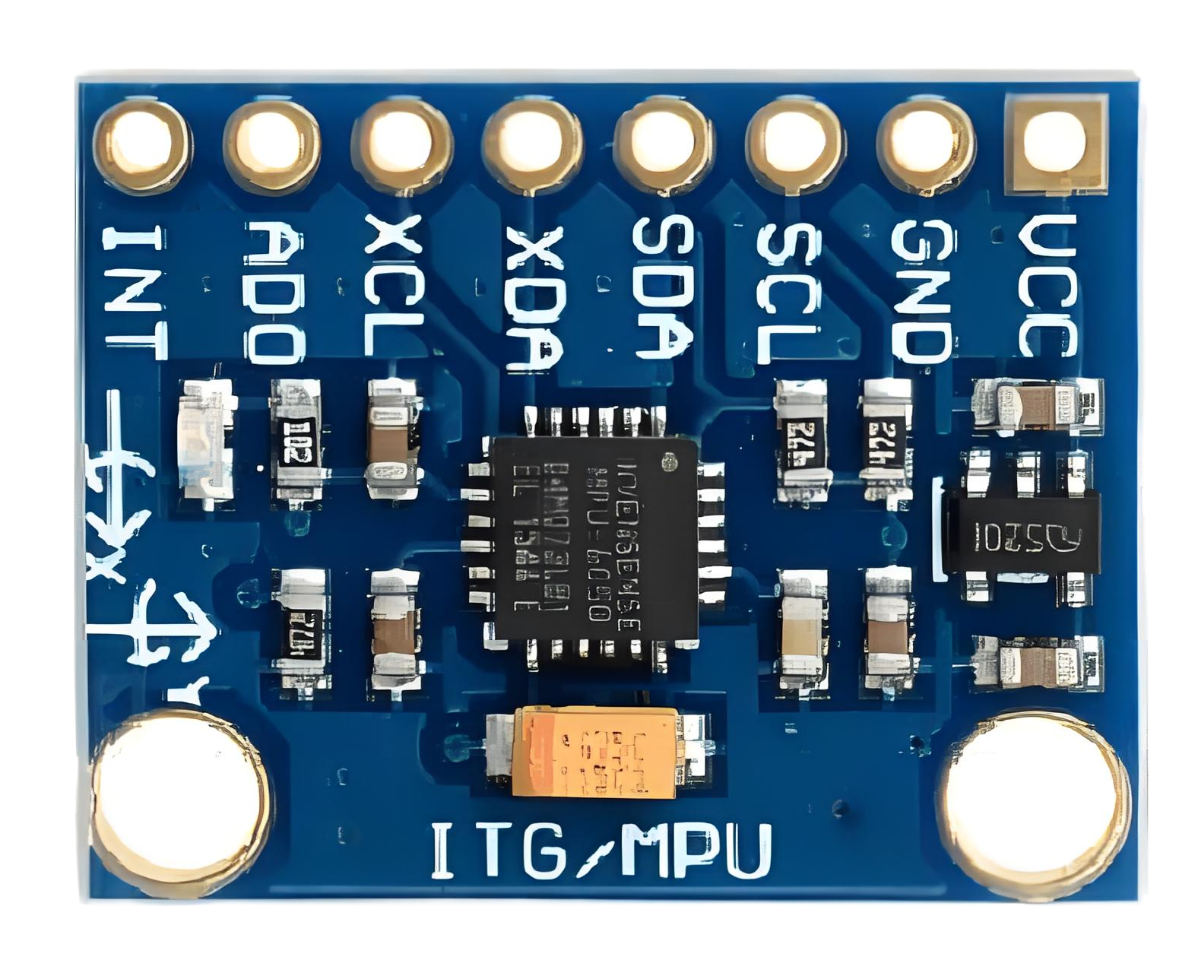
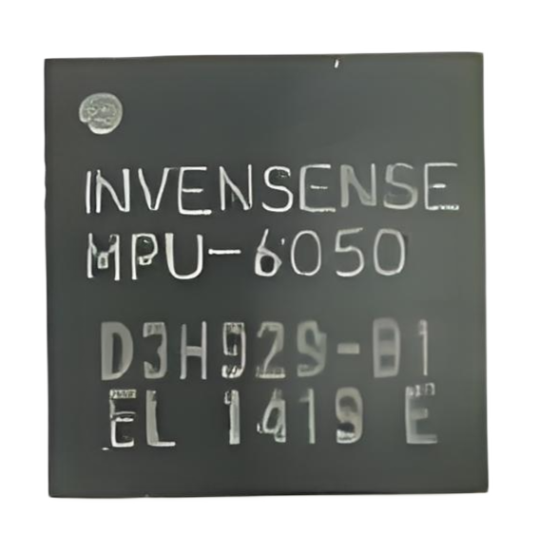















Slide 2
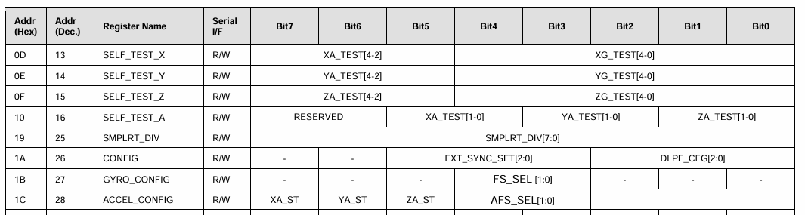
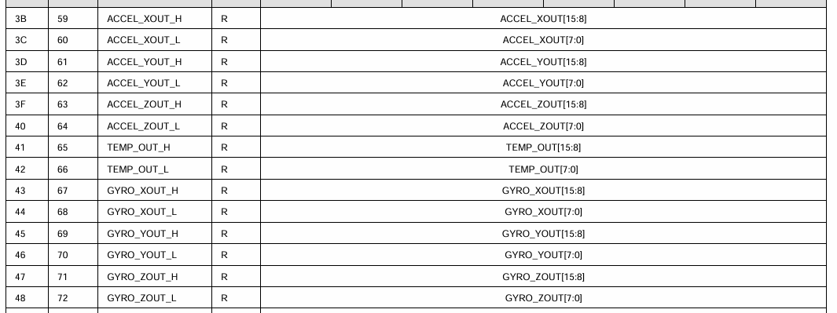







I2C_SCL
I2C_SDA

Slide 3
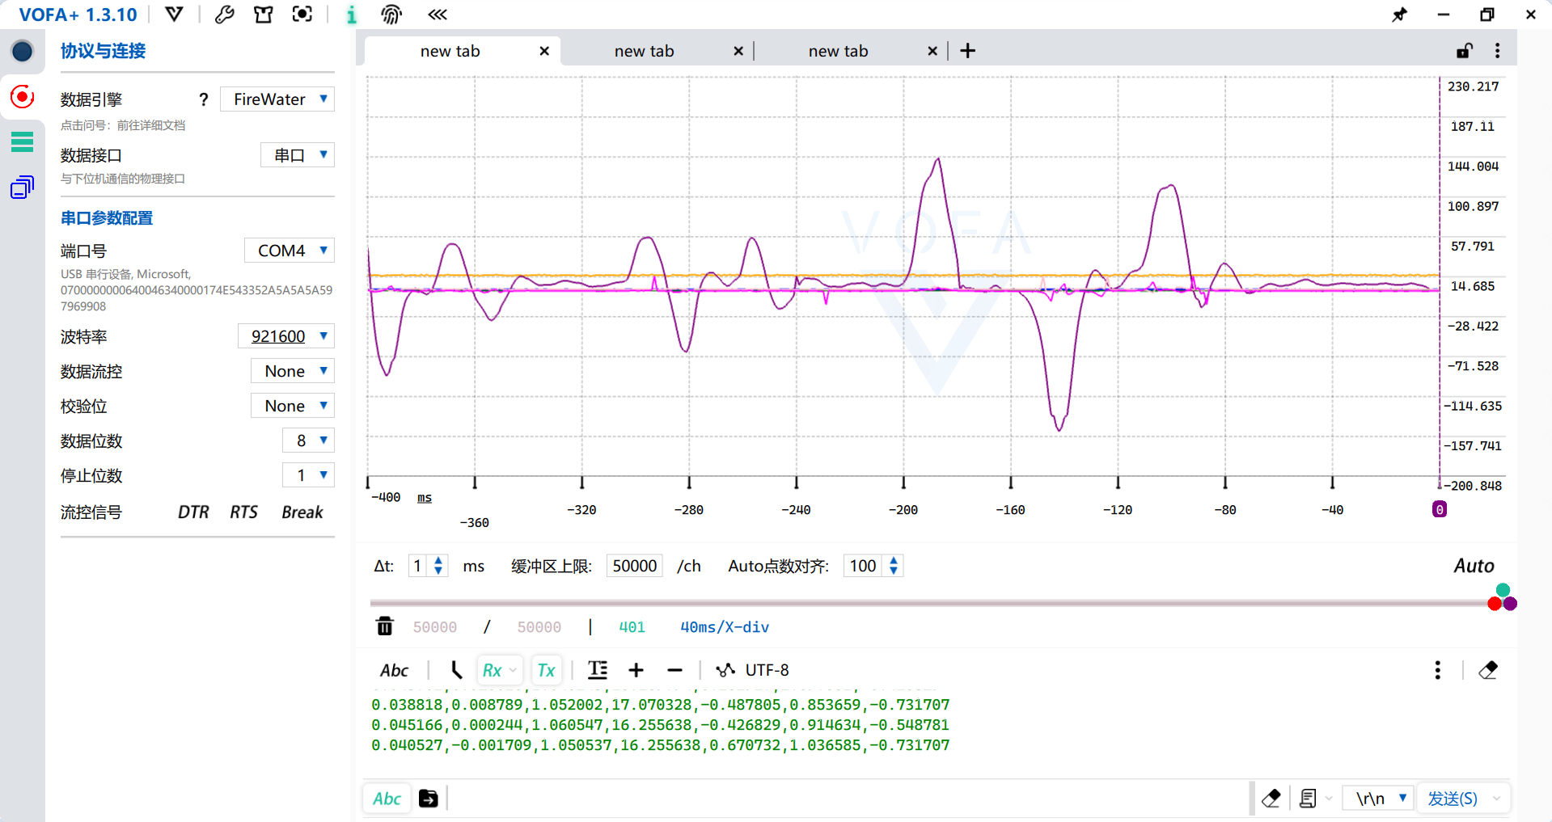


I2C_SCL
I2C_SDA

Slide 4
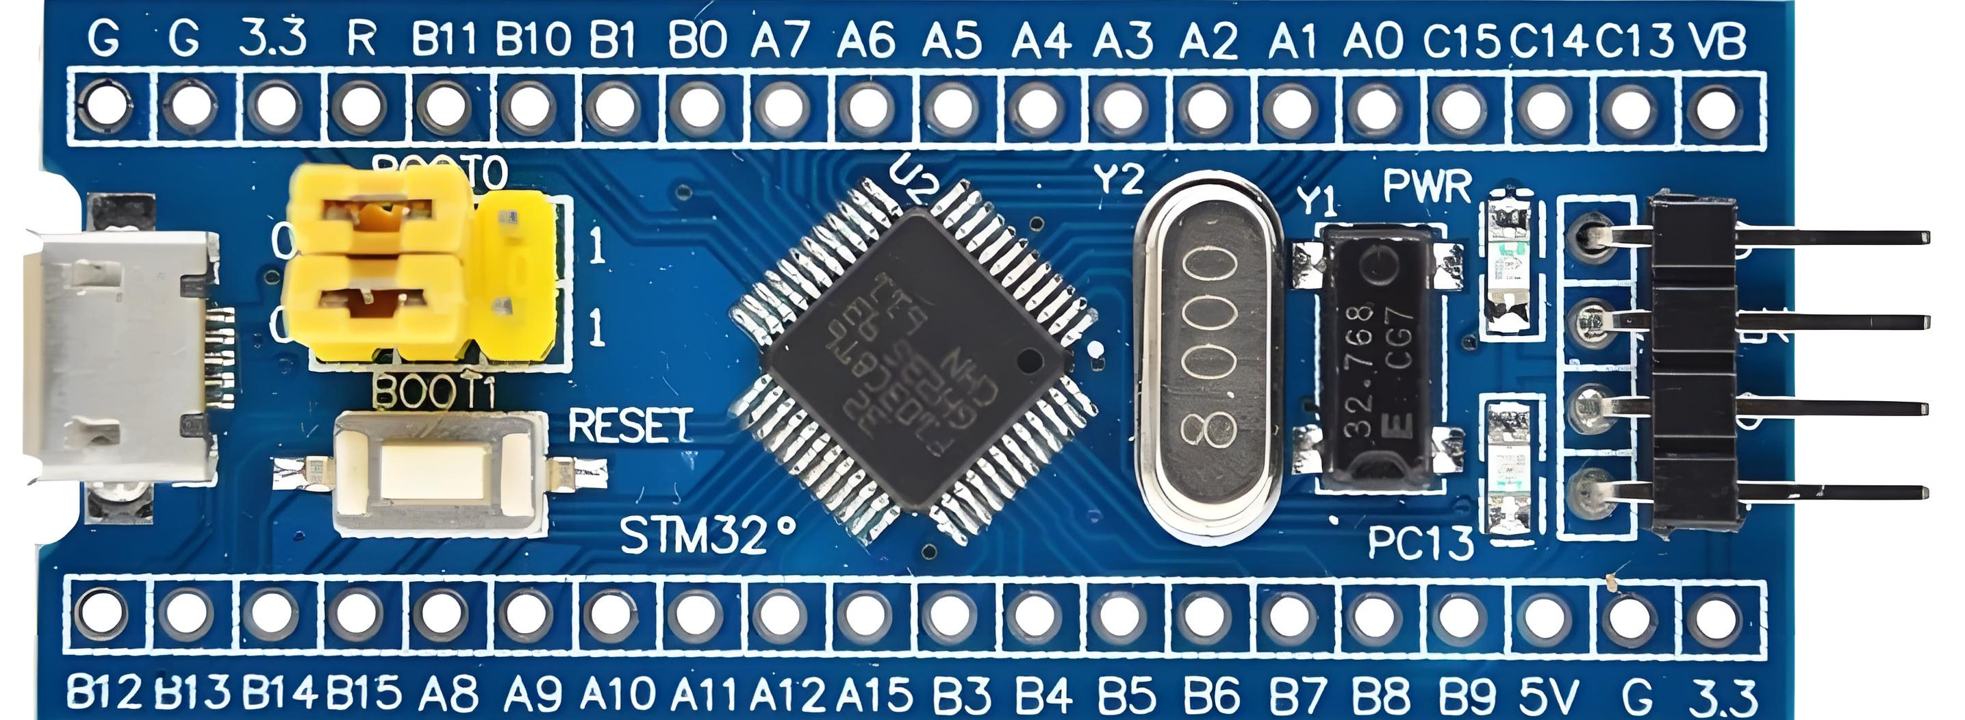
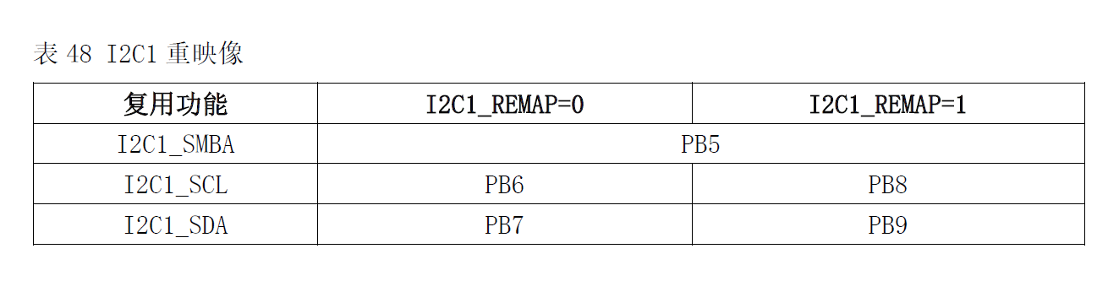
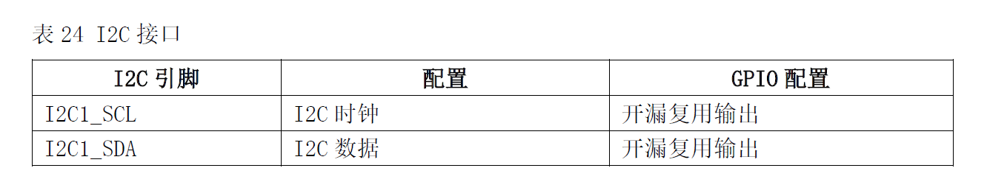

3.3V
3.3V
I2C_SCL
I2C_SDA

Slide 5







I2C_SCL
I2C_SDA

Slide 6

// 向寄存器0x1b写入值0x18
i2c_send_bytes(0xd0, {0x1b,0x18})
// 例如：读取寄存器0x3b的值
i2c_send_bytes(0xd0,0x3b);
regVal = i2c_receive_bytes(0xd0);

Slide 8

I2C_SCL
I2C_SDA

Slide 9
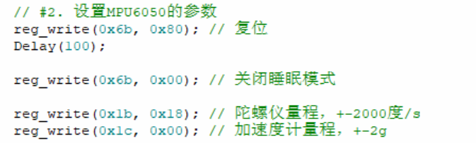
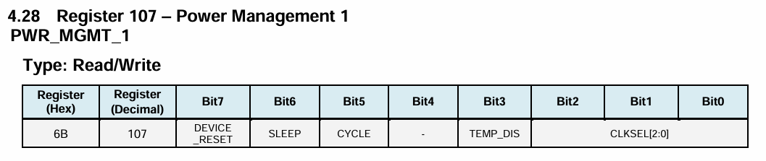



Slide 10
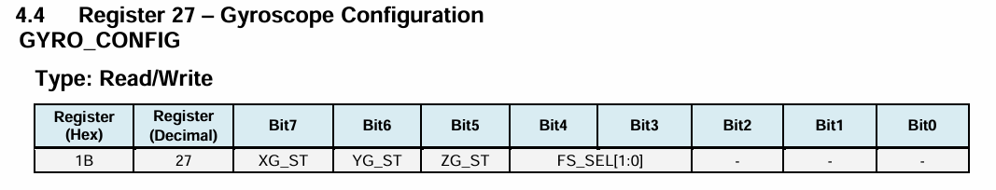
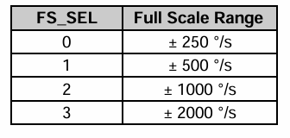


Slide 11
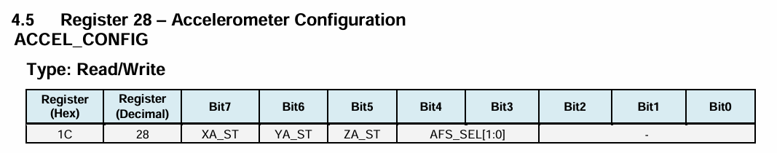
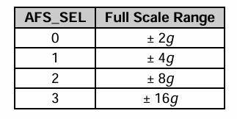


Slide 12
I2C_SCL
I2C_SDA

Slide 13


uint8_t accel_xout_h = reg_read(0xd0,0x3b);
uint8_t accel_xout_l = reg_read(0xd0,0x3c);
int16_t ax_raw = accel_xout_l + (accel_xout_h << 8);
int16_t ax_raw = (reg_read(0xd0,0x3b) << 8) + reg_read(0xd0,0x3c);

Slide 15


